Slide 1



CERTIFICATE VERIFICATION
Problem statement:
TEAM MEMBER: PAVITHRA M

Slide 2

AGENDA
Introduction
Development pipeline
Technologies stack
Front-end: HTML, CSS, Bootstrap
Back-end: Block-chain(Xinfin network), Solidity
File Storage System: IPFS
Advantages

Slide 3
INTRODUCTION
The inspiration for this project came upon mainly to resolve the manual work of verifying marksheets and to check the genuinity of the marksheets provided by the institution .
The purpose of this project is to reduce the time taken for the certificate verification process.
To keep the records safely in the Block Chain without any third-party involvement in a decentralized environment safely.

Slide 4
ABSTRACT
The core purpose of this project is to reduce the time taken for the certificate verification process that takes place in an Institute/Universities and to keep the records of all present and passed out batches and their respective mark sheets/ certificates permanently in the blockchain.
Once the mark sheet image is uploaded via IPFS to the blockchain , it is immutable . No records/data of the mark sheet can be deleted.
It reduces the fraudulent activities i.e., submission of fake marksheets.

Slide 5
ABSTRACT (contd)
The time taken to verify the mark sheet is minimal compared to manual verification of the mark sheet.
The data is safe and secure in blockchain. Only those people who have user access can login & can verify their hash code.
It is a Dapp (Decentralized application) that runs on a peer - to - peer blockchain network. A single user cannot control the whole network as this is decentralized.

Slide 6
DEVELOPMENT PIPELINE (Certificate Authority)
Hash Storing
File Uploading
Uploading student details
Uploading Marksheet
Generate Hash through IPFS
The generated hash is stored in blockchain network
(i.e.Xinfin)
Front End
Hash Generation

Slide 7
DEVELOPMENT PIPELINE(User Side)
File Uploading
Final Verification
Request the login credentials from the certificate authority
After receiving the login credentials they can upload the certificate
Admin checks the equality of both the hashes
If both the hash are equal then certificate is genuine , else it is not genuine.
Request Credentials
Checking

Slide 8
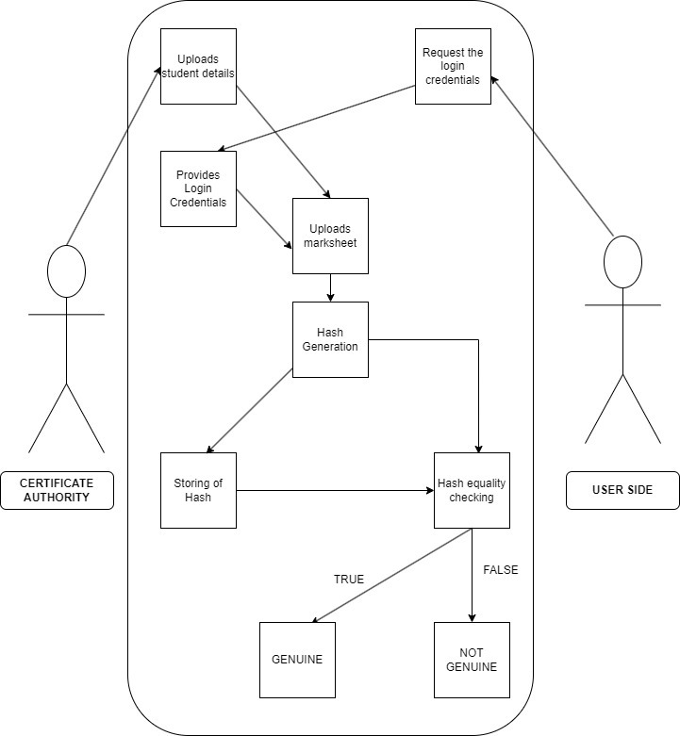
USE CASE DIAGRAM:

Slide 9
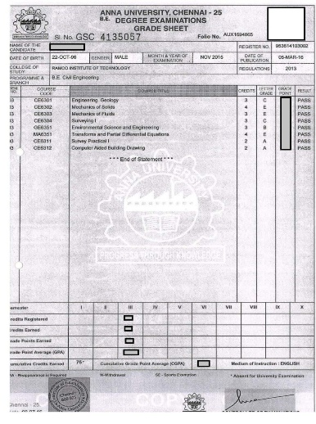

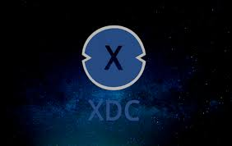
TECHNOLOGY STACK
Block-chain (Xinfin)
IPFS-(Data Storing And Retrieving)
Web application:
Front-end: HTML, CSS, bootstrap ,React JS
Smart contract storage: Solidity
File Storage system: IPFS

Slide 10
ADVANTAGES
Manual work can be reduced or eliminated .
It reduces the paper work and more efficient compared to the traditional way.
Even small changes in the certificate can be detected easily.
Provides better security.
It reduces the cost and time.

Slide 11
THANK YOU

